Slide 1

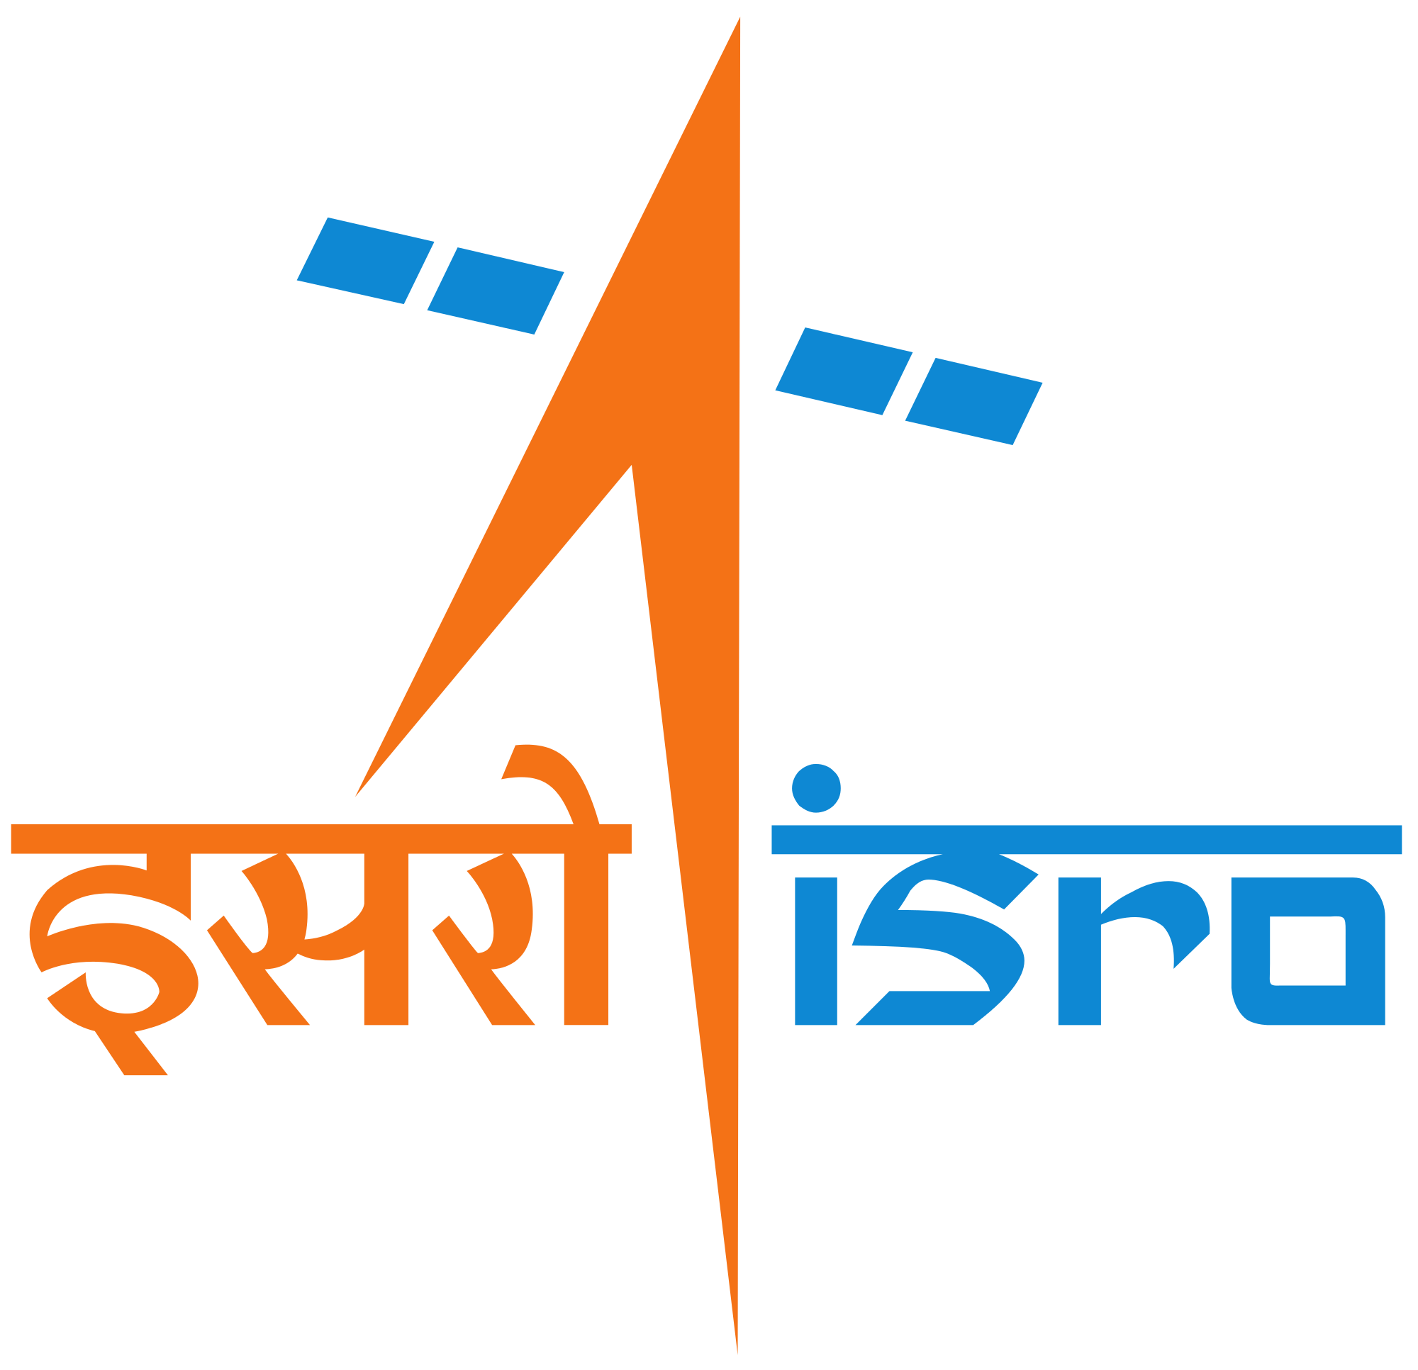
Project Title:
DEVELOPMENT OF A WEB APP WITH MAP BASED GUI FOR REAL TIME INLAND WATER LEVEL MONITORING USING SATELLITE ALTIMETRY
IIRS PS-1 Presentation (July 2018)
Prepared By: Prithvi Raj (2016A7PS0013P)
Abhiroop Bhattacharjee (2016A3PS0702P)
Project Supervisor: Dr. S.P. Aggarwal
Department: WRD
Programme Coordinators: (IIRS) Dr. Shefali Agarwal
(BITS) Dr. Chandra Shekhar

Slide 2
OBJECTIVES
Automating the process of-
Checking for availability of new satellite data on the web
Downloading all new files available
Processing the netCDF files to get the elevation of required locations
Improvement in accuracy of elevation assessment by-
Determining longitudinal and latitudinal tolerance to be given so as to get points which lie only within the water body of choice
Determining offset between the satellite’s actual ground track (from netCDF file) and offline ground track (from .kmz file)
Development of a web app-
Map based GUI for geo-visualisation
Plotting of elevation data

Slide 3
ALTIMETRY
Altimetry is a technique for measuring elevation. Satellite altimetry measures the time taken by a radar pulse to travel from the satellite antenna to the surface and back to the satellite receiver. Combined with precise satellite location data, altimetry measurements yield water-surface heights.
A lot of other information can be extracted from altimetry apart from altitude. The magnitude and shape of the echoes (or waveforms) also contain information about the characteristics of the surface which caused the reflection.

Slide 4
JASON 2/3
Parameters | Jason 2 | Jason 3
Operator | NASA, CNES | NASA, CNES
Launch Date | June 20, 2008 | January 17, 2016
Purpose | Ensuring continuity of high quality measurements that Jason 1 provided for ocean science and providing operational products for assimilation and forecasting applications. | Ensuring continuity of high quality measurements that Jason 2 provided for ocean science and providing operational products for assimilation and forecasting applications.
Orbit | Geocentric | Geocentric
Orbital period | 112.57 minutes | 112.42 minutes
Repeativity | ~10 days | ~10 days
Footprint / Resolution | ~10 km (~500m at 20Hz PRF) | ~10 km (~500m at 20Hz PRF)

Slide 5
Objective 1
Automation

Slide 6
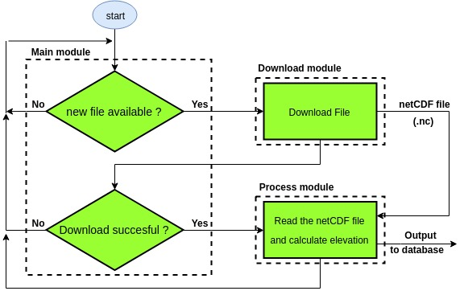
METHODOLOGY

Slide 7
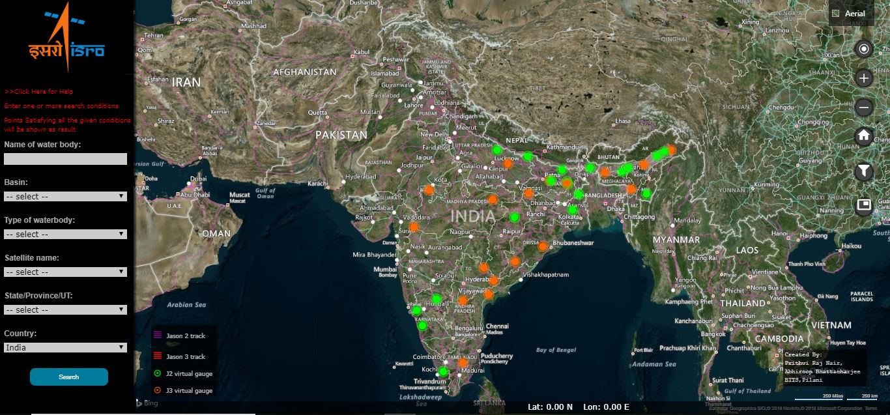
OUTCOME
The automation script automatically downloads and saves the altitudes for the locations shown in the map.

Slide 8
Objective 2
Improvement in accuracy

Slide 9
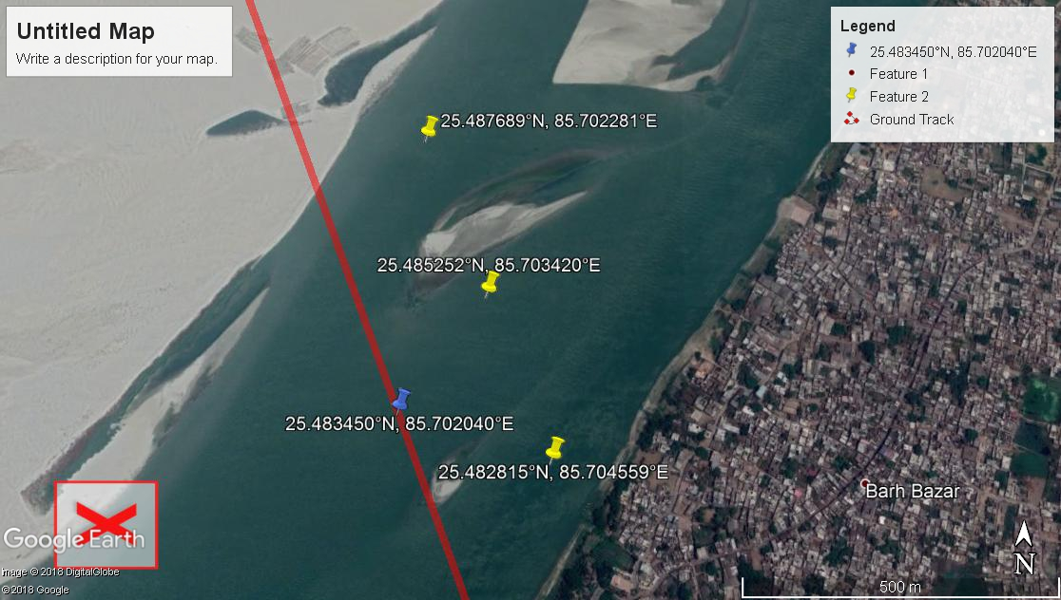
METHODOLOGY
Determining offset

Slide 10
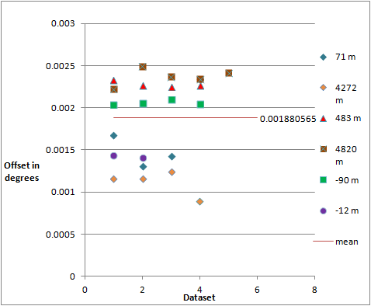
Fig : Plot showing the various longitudinal offsets

Slide 11
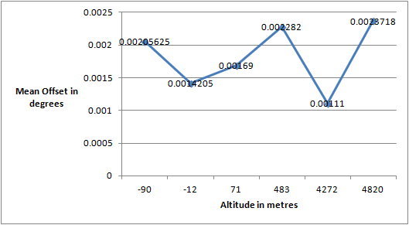
Fig : Plot between mean longitudinal offset and altitude

Slide 12
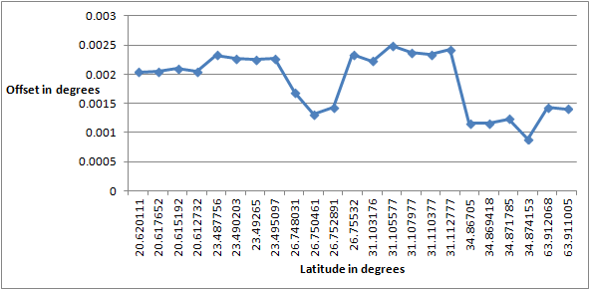
Fig : Plot between longitudinal offset and latitude

Slide 13
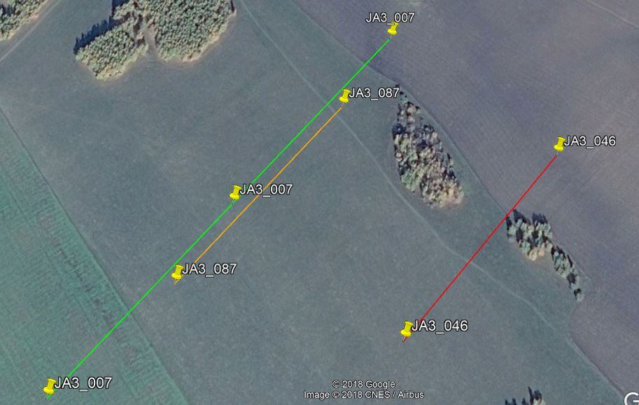
Fig : Variation of satellite track with time

Slide 14
OUTCOME
The variation of longitudinal offsets with latitude and altitude is determined to be arbitrary.
The drift of satellite with time is also determined to be arbitrary

Slide 15
Objective 3
Development of web app

Slide 16
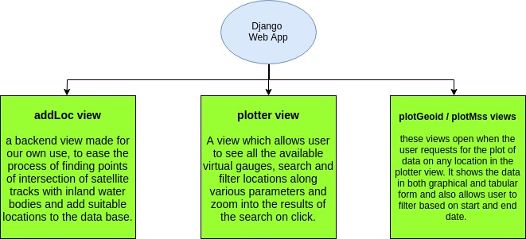
METHODOLOGY
Web app views

Slide 17
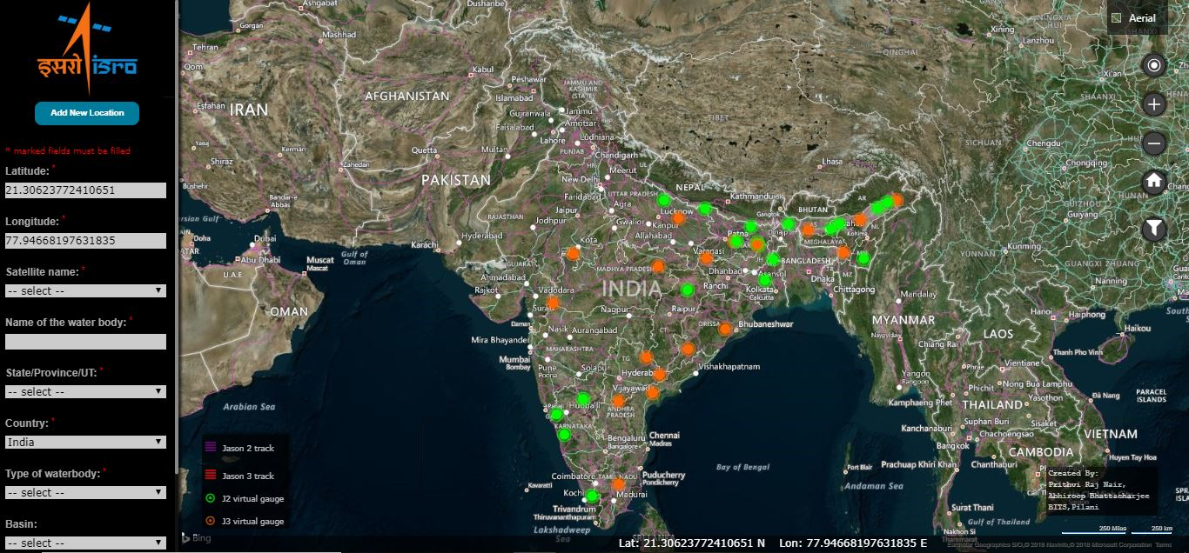
OUTCOME
addLoc view

Slide 18
OUTCOME
plotter view

Slide 19
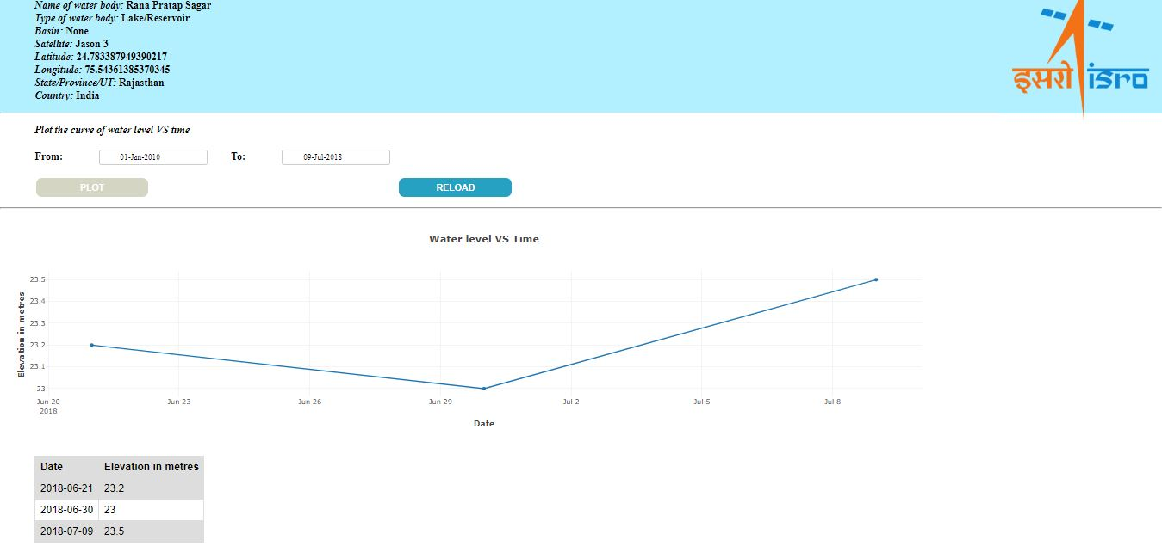
OUTCOME
plotMss / plotGeoid view

Slide 20
CHALLENGES
Challenges | Status | Solution
Running BRAT software using python script to process the netCDF files | solved | Read netCDF files directly using python netCDF4 module
Determining offset between satellite’s actual track and kmz file | solved | Offset determined to be arbitrary with altitude,latitude and time
Determining tolerance to be given so as to get points only within the waterbody of choice | solved | After trial and error, the tolerance is suitably estimated to be 0.0045º for Indian region
Incorporating other satellites into the data collection part (Currently only JASON 2 /3) | Not solved

Slide 21
CONCLUSIONS
Most of the work that has been automated was earlier being done either manually which is very inconvenient.
All the functions have been implemented using open source software.
Better interface for the end user - The graphical user interface with map allows better geo-visualisation of the altimetry data.
The web app would allow effective monitoring of water levels at various locations.
Real time plots (at most a few hours delay) are available at just one click and therefore it is a lot easier to monitor elevation on a frequent basis.

Slide 22
ACKNOWLEDGEMENTS
The entire Practice School experience, has been a great learning experience. To all the people who made that possible, we extend our sincere gratitude and appreciation.
Firstly, we thank Dr. Prakash Chauhan, Director of IIRS, Dehradun for giving us this wonderful opportunity and providing us with all the necessary facilities.
We extend our most sincere gratitude to Dr. S.P. Aggarwal, Group Head of Water Resources Department, IIRS, for providing us with the opportunity to work on this project and for his valuable guidance at each and every step throughout.
We are also thankful to Mrs. Shefali Agarwal, Group Head of Geospatial Technology and Outreach Programme, IIRS, for her valuable support.
In addition, we wish to extend our gratitude to our PS Instructor, Dr. Chandra Shekhar, Associate Professor at BITS, Pilani – Pilani Campus, for his guidance, advice and support.

Slide 23
THANK YOU

